Slide 1

DEVELOPING AND TESTING CROSS PLATFORM COMPATIBLE MODULES WITH POWERSHELL CORE
MARK WRAGG
DevOps Engineer, XE.com
DD
@markwragg
https://wragg.io
Notes:
Hello everyone. I am MW, DevOps Engineer @ XE.
This talk is about developing cross-platform compatible code.
Authoring cross-platform code isn’t particularly difficult.
There are some potential pitfalls and I want to demo CI for how to automate testing.

Slide 2

THE PROBLEM
Automate deployment of static content files
Support two deployment scenarios:
Dev: Deploy changes during regular monthly releases
Ops: deploy between releases and without downtime
Allow only modified files to be deployed when required.
Notes:
I want to start by explaining the problem that inspired this talk.
Was tasked with automating deployment of static content files. These files are used to define things like email templates, web pages.
The files can be changed in one of two ways:
- Developers make a change as part of regular/monthly release.
- Ops make a change between releases when the business asks for it. Often ASAP.
Dev changes are in Source Control but Ops changes were not. Wanted all to be in SC.
Further to avoid downtime wanted to be able to deploy just modified files but this was difficult because SC removed modified dates.

Slide 3

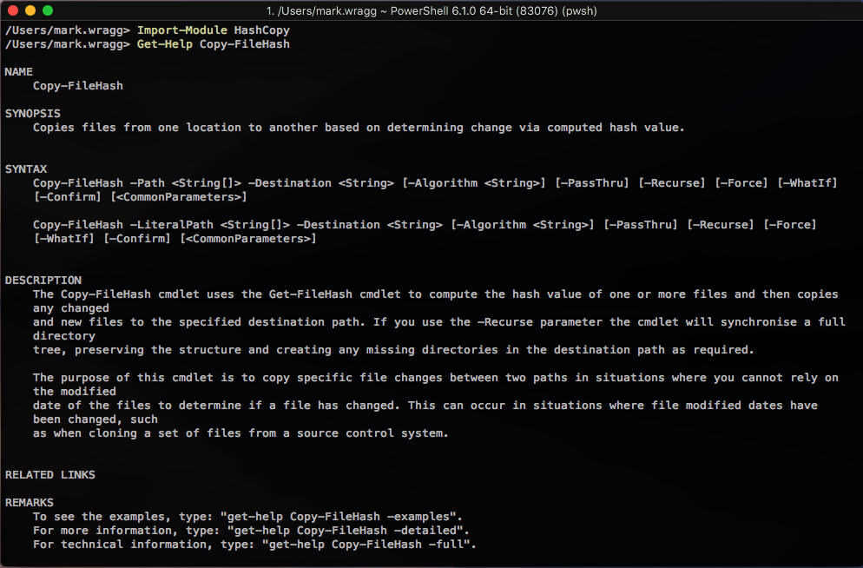
THE SOLUTION
Notes:
My solution was to author this cmdlet: Copy-FileHash.
This cmdlet wraps Get-FileHash with Copy-Item.
Get-FileHash comes from DSC, and can be used to compare files via calculated hash value.
Files in SC were canonical, so if they’re different SC version should be used.
So now can drop files in temp dir and use this cmdlet to copy just files that have changed.
This was written to solve a problem on Windows, but as I have a Mac, PSCore was my only choice locally.
Looking at the code, there wasn’t much to stop this being cross-compatible.
**look at cmdlet**

Slide 4

POWERSHELL CORE
New, fast
Open-source, cross-platform
Not all cmdlets available / modules compatible
Notes:
Wanted to take a step back at this point and just cover what PSCore is in case anyone isn’t aware.
Started as fork of Windows PowerShell but is now radically different.
Built in .NET Core vs .NET Framework which is why is cross-platform.
Open Source.
Version 6.1 is latest but despite version numbers is new/different.
Not all cmdlets are available and not all cmdlets are same.

Slide 5

THINGS TO CONSIDER
Cmdlet availability / avoid aliases.
File paths: use forward slashes, reference system paths via environment variables, use –path cmdlets.
Encode as UTF8.
Notes:
Cmdlet availability will be consistent across PS Core, but if you’re authoring something to work on Windows PowerShell and PS Core then cmdlet availability/compatibility is a concern.
Avoid using aliases, Unix systems tend to default to built in commands so ls will be system ls not get-childitem like on Windows.
Was personally tripped up recently by “sort”.
Handle paths with forward slashes and use –path cmdlets to offload path handling where possible.
Encode as UTF8.

Slide 6

WHY WRITE CROSS-PLATFORM?
To be a good citizen (if you can, you should).
Because PowerShell Core is the future of PowerShell.
To make your code accessible to a wider audience.
WHEN SHOULD YOU NOT?
When your code does something unique to Windows.
When you’re certain your code will only be used on Windows.
Notes:
To be a good PS citizen.
Because PS Core is the future, Win PS is just bugfixes.
To get more feedback, reach more people.
Don’t bother if you’re writing something only useful on Windows or one specific OS. E.g a module that works with Windows services.

Slide 7

TESTING YOUR CODE
Pester is the PowerShell testing framework.
Beware the same cross-platform considerations apply to your test code (e.g. be wary of how you handle paths).
A thorough set of tests is the best way to catch compatibility issues.
Notes:
If you want to ensure your code works cross platform you really want to have some automated tests. Pester is the answer to that and is great.
Beware the same considerations apply to your test scripts: paths etc.

Slide 8

DEMO: APPVEYOR
Leveraging the free Continuous Integration service AppVeyor to perform per-commit Pester testing of code on both a Linux and Windows VM.
Notes:
AppVeyor is a CI tool. There’s also Azure DevOps, CircleCI, TravisCI, Jenkins and others.
AppVeyor is free. It’s aimed at Windows / .NET projects but can now be used to test on Unix.
Connect it to your GitHub account to have tests run every time you commit.
** go do demo **

Slide 9

SUMMARY
Review your existing code for opportunities to make it cross-platform (or confirm if it already is!).
You can ensure your code remains cross-platform compatible via automated testing.
Tag your PS Core compatible code as such in the PS Gallery.
Links:
https://www.powershellgallery.com/packages/HashCopy/
https://github.com/markwragg/PowerShell-HashCopy
https://www.appveyor.com/
Twitter: @markwragg
Blog: https://wragg.io

